Slide 1
Understanding Human Emotions: The DistilBERT-CNN Way
Manas Ranjan Sahoo
Chelsea Salyards
Deep Learning (Summer Semester, 2025)
Dr. Youakim Badr

Slide 2
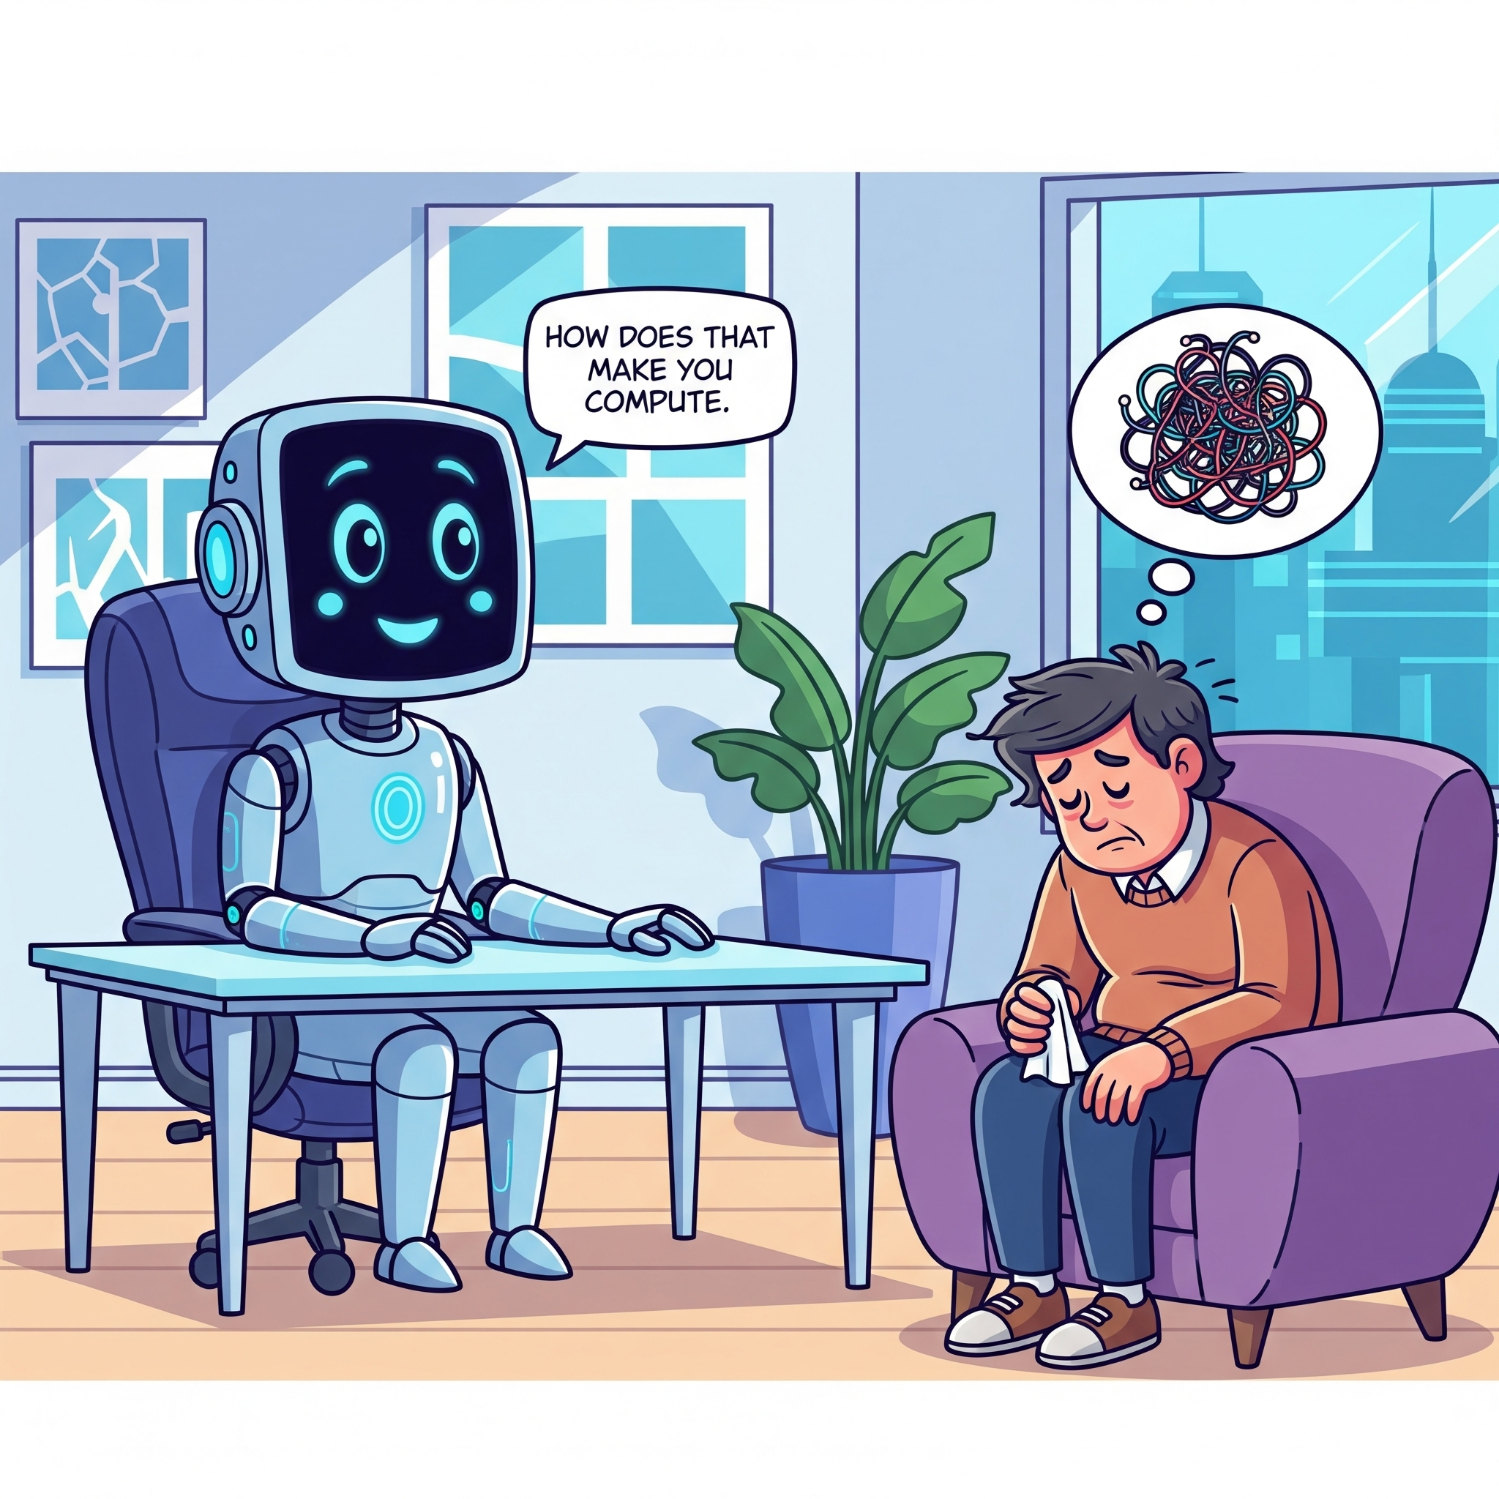


Why Fine-Grained Sentiment Analysis?
Sentiment analysis is crucial for modern AI
Vital for applications like AI therapists, chatbots, social media monitoring for harmful content, recommendation engines
Elevating AI from transactional to more human-like empathetic mode will increase adoption
AI Generated Images

Slide 3

Challenges in Emotion Recognition
Despite decades of research, accurate sentiment analysis is still challenging
Nuances like sarcasm and irony
Importance of context
Cultural and linguistic differences
Lack of high-quality, large-scale dataset
That's a brilliant idea !
That's just great!
Gift (EN) vs Gift (Nordic)
AI Generated Image

Slide 4
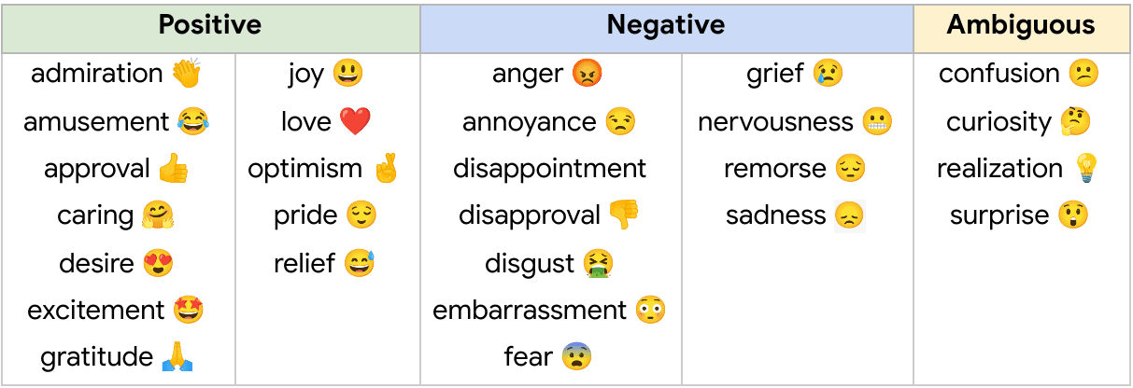
Opportunity At Hand
GoEmotions is the largest human-annotated dataset of its kind
Made up of 211,225 entries from Reddit
Multiple raters rated 58,000 of these entries
Rated entries were used to train their original BERT model for sentiment analysis.
Our objective – Improve the existing sentiment analysis model using a novel deep learning architecture
Credit: Neurohive.io

Slide 5
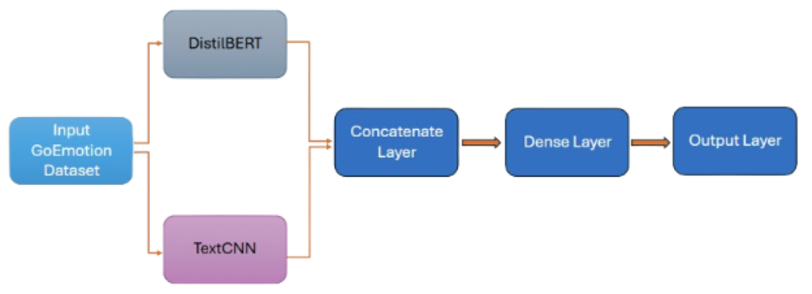
Overview of Solution / Contributions
Creating a novel deep learning architecture
Prior Work (Google Research)
BERT – large transformer/encoder-based model widely used in natural language processing applications
Our Modifications
Upgrading the architecture to a hybrid multi-input single-output model
Use DistilBERT as an input replacing BERT for a faster equally-effective version to capture global and local patterns
Use TextCNN as another input using CNN with an added focus to capture local context through n-grams
Initial Draft Architecture

Slide 6
Architecture In Details
Replacing BERT
BERT is a very large model, and our machines do not have the resources to run it effectively
To mitigate this, chose to migrate to smaller BERT variant, DistilBERT
40% smaller than BERT
60% faster in inference timing
Still retains 97% of the F1-score of the normal BERT implementation (Sanh et al. 2019)

Slide 7
Architecture In Details
Adding a CNN input arm
Various studies supported the idea of hybrid models (including BERT-CNN models having superior results to BERT only models
Abas et al.
Duong, Lebret, and Abererécole.
Gou, Lei.
Chose TextCNN as basis for implementation
CNN originally invented for computer vision
TextCNN is a variant that was designed for use with text

Slide 8
Architecture In Details
Interpreting the results
The output is a multilabel indicator matrix
Predicts one or many of the 28 emotions (27 emotions + neutral) as an outcome
Credit: Neurohive.io

Slide 9
Related solutions / State of Art
Guo, Yuan and Li, Hongmei. "Research on Sentiment Analysis of Online Course Evaluation Based on EN-BERT-CNN"
Uses BERT-CNN hybrid model to learn sentiment from a dataset of online course reviews
Evaluates BERT-CNN versus other hybrid architectures
Recognizes strengths of BERT-CNN, but notes weakness to bad datasets
Wang, et al. "A BERT-based sentiment analysis model for depressive text"
Evaluates using plain BERT for conducting sentiment analysis to identify depression in written text
Acknowledges the issue of unbalanced data and utilizes data augmentation as a solution
Also acknowledges using weights as another solution, which was the methodology used in GoEmotions

Slide 10
Related solutions / State of Art
Kian Long Tan, Chin Poo Lee, Kalaiarasi Sonai Muthu Anbananthen, and Kian Ming Lim. "RoBERTa-LSTM: A Hybrid Model for Sentiment Analysis With Transformer and Recurrent Neural Network"
Involves using a different type of BERT hybrid architecture – using LSTM
Uses RoBERTa BERT variant, an improved BERT model that is more effective than original, but very large
Methodology with LSTM did prove effective, which shows potential avenues for improvement on machines with greater resources/more time to train
Kokab, et al. "Transformer-based deep learning models for the sentiment analysis of social media data"
Another alternative hybrid architecture using BERT; uses BERT and CBRNN
Describes the advantages of such an architecture and strengths/weaknesses of others

Slide 11
Problem and Challenges
Compatibility issues with outdated APIs (Tensorflow 1 and Estimators) in original GoEmotions project
Refactored code to Tensorflow 2 and Keras
Compatibility issues with TextCNN project (written in PyTorch)
Refactored code to Tensorflow/Keras
HuggingFace updates
HuggingFace very recently updated their model weight format which broke our code late in our development
Unexpected complication after we thought our code was essentially finalized
Needed to pull newly released version of safetensors to resolve
Needed to alter code to download/store pretrained DistilBERT model instead of redownloading it every time to mitigate this from happening again

Slide 12
Problem and Challenges
System limitations
Intended to resolve by just migrating to smaller BERT model: DistilBERT, still struggled
Ultimately migrated code to Jupyter Notebook and running code in cloud environment

Slide 13
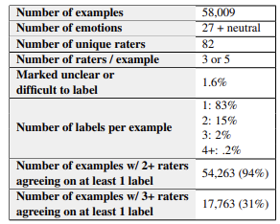
Data Collecting
Data was sourced by GoEmotions team consisting of researchers from a collaboration of Stanford Linguistics and Google Research
Final dataset contains 58,000 Reddit comments labeled with 27 emotion categories + neutral
Selected subreddits based on popularity, likelihood of demonstrating a variety of emotions versus neutral or overly positive/negative tones, less likelihood of offensive/harmful content
Comments categorized by at least three independent raters
More added if raters did not agree
Credit: Google Research

Slide 14
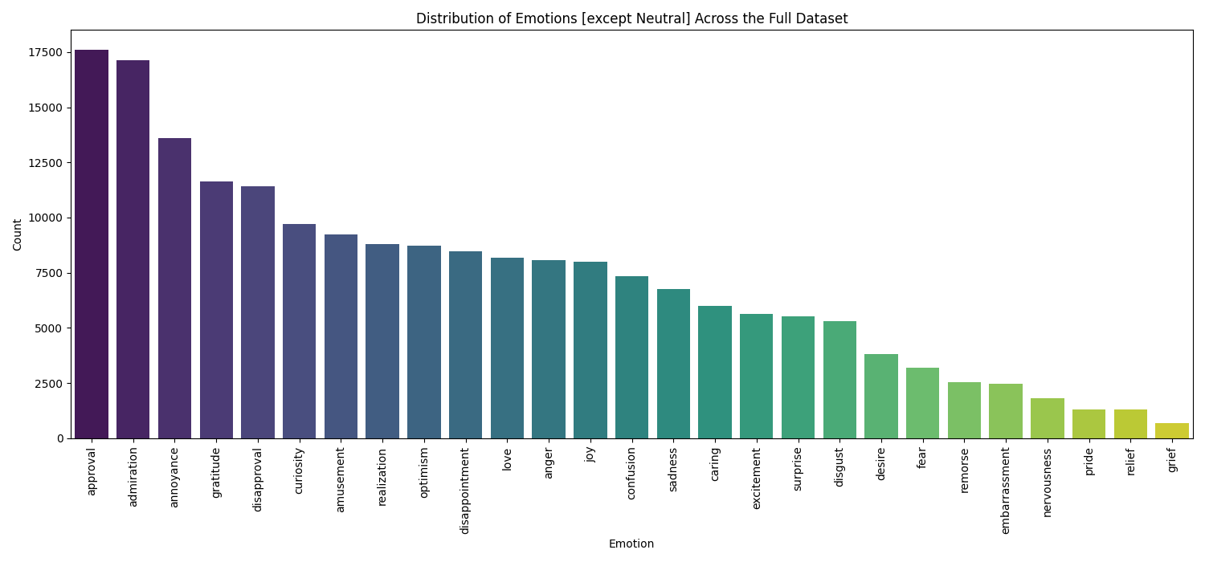
Data Preprocessing
Data cleanup:
Original GoEmotions team performed several tasks to preprocess their data
Removed offensive/harmful words from collected data, while keeping profanity to help train negative emotions
Removed and filter text that was too ambiguous for the raters to detect emotion
Data regularization on Reddit comment length to down sample to more consistent number of tokens

Slide 15
Data Preprocessing
Handling uneven categories through sentiment relationship:
Number of examples in emotion categories remain uneven, even with specific data selection efforts
Original team used weights and bias algorithms to allow emotion categories with rarer labels to learn from related emotions
Sentiment grouping
All 27 emotions used as categorization labels were organized into higher level groupings, and model would learn from those groupings
Model can extract info and train based on other emotions
Additional class imbalance is handled through a weighted loss function in the custom loss function to penalize misclassification in minor classes.
positive | amusement, excitement, joy, love, desire, optimism, caring, pride, admiration, gratitude, relief, approval
negative | fear, nervousness, remorse, embarrassment, disappointment, sadness, grief, disgust, anger, annoyance, disapproval
ambiguous | realization, surprise, curiosity, confusion

Slide 16
Data Preprocessing
Handling uneven categories through emotion correlation
Correlation grouping
While the original work did mention about correlation, the correlation related code wasn't available for use.
Recreated the functionality using the details mentioned in the original work
Purpose is to show where emotions tend to be expressed together, demonstrating different type of relationship
Helps add another valid training point to add learning to rarer emotion categories

Slide 17
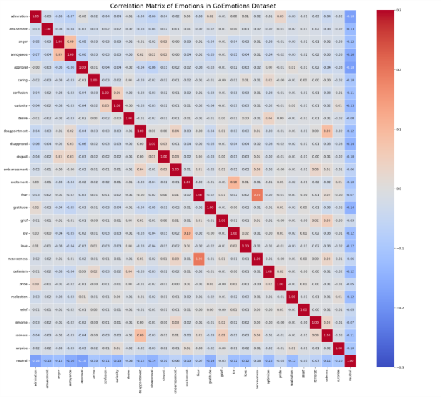
Data Preprocessing
Correlation matrix demonstrates calculated relationships
Highlights of highest values of correlated emotions:
Nervousness and fear: .2
Joy and excitement: .1
Anger and annoyance: .09
Disappointment and sadness: .09

Slide 18
Custom Function Utilization
Custom functions were used to handle data imbalance and fine tune training
Custom loss function – Incorporates regularization apart from loss calculation
Calculates base loss
Add weighted-loss function based on class distribution penalizing loss in minority classes
Add sentiment regularization if model predicts different sentiment groups together
Add correlation regularization if model predicts less correlated emotions together
Activation function swaps based on multilabel flag in our config
Multilabel: Sigmoid activation function
Single label: SoftMax activation function
Focused on multilabel classification for our project's evaluation

Slide 19
Custom Function Utilization
Custom functions (cont.)
Custom learning rate function for AdamW – creates a 2 stage learning rate schedule
Starts with warmup for a few steps to stabilize the model (0 to a fixed learning rate)
Fine tunes the model for the remaining number of steps with a decay rate (fixed learning rate to 0)
Custom classifier function – Used in place of Keras Dense layer to predict the emotion using custom weights and biases.
Custom metrics function - Standard F1 metrics are better for single-label problems and a weighted F1 score metric is better suited for multi-label class imbalanced cases.

Slide 20
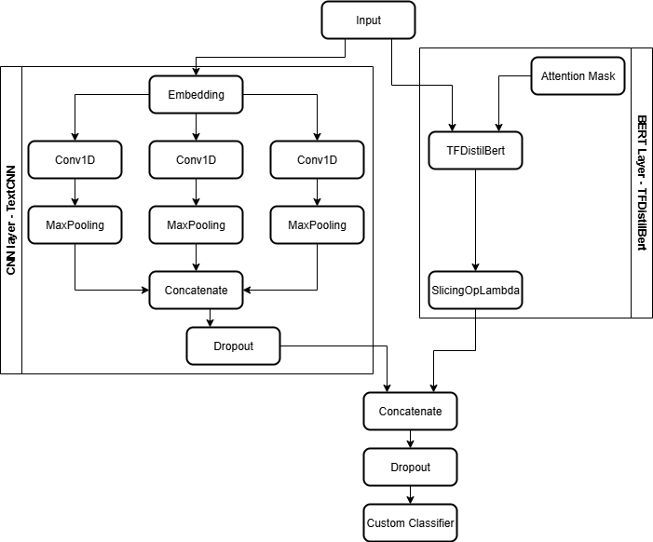
Methodology
Final Network Architecture
Multi-Input Single-Output Hybrid Model
Input 1 – DistilBERT
Input 2 – TextCNN
Output – Multi-label emotion prediction matrix

Slide 21
Methodology
TFDistilBert layer
Input & Attention Mask – Tokenized text and Attention vector for model to focus on real content and not padding
TFDistilBert – Using self-attention mechanism find the importance of each word with respect to other words to understand global context.
SlicingOpLambda - To extract the embedding of the first token as a summary vector of text.
TextCNN layer
Designed to capture local patterns & features through n-grams
Embedding layer – tokenizes words into dense vector
Conv1D – use filters of different sizes to capture local patterns
MaxPooling – Reduces dimensionality keeping most significant feature
Concatenate – Create a summary of the most important local features or patterns across all filters.
Dropout – Regularization technique to prevent overfitting.

Slide 22
Methodology
Combined Layer
Concatenate – Output vector of TextCNN (local context) and output vector of DistilBert (global context) are combined into single vector.
Dropout – Regularization layer to prevent overfitting
Custom Classifier - The final vector passes through the custom classifier to provide emotion prediction

Slide 23
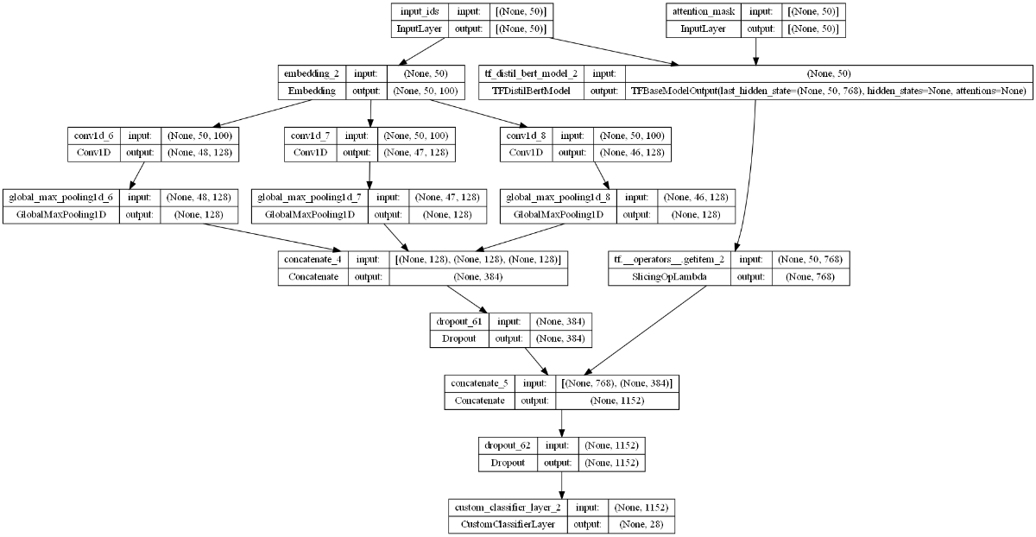
Methodology

Slide 24
Network Training – validation - testing
The complete labeled dataset of 58000 records were split as:
Train – 80%
Validation – 10%
Test – 10%
Additional configurations:
Batch size – 16
Initial Learning Rate – 5e^-5
Learning Rate Warmup – 10% of steps
Epochs - 20
Early Stopping Patience (to prevent overfitting) – 4 epochs

Slide 25
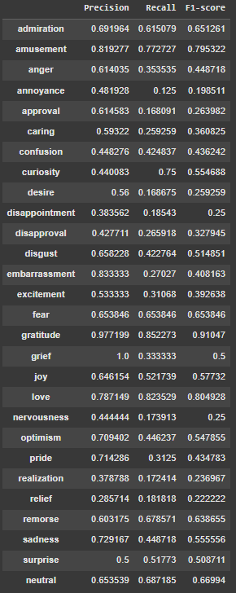
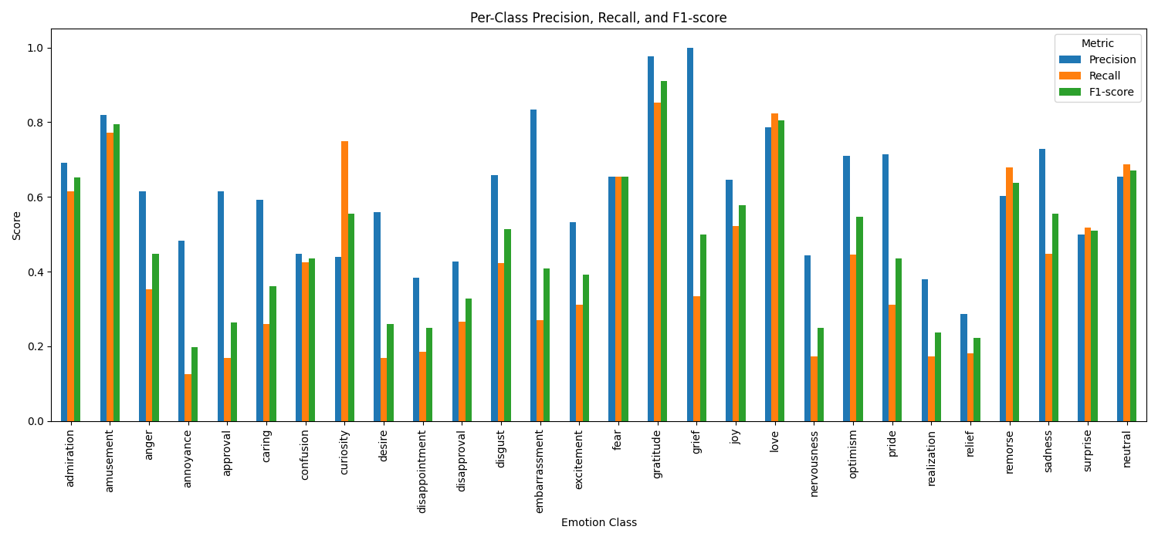
Outcomes/Findings

Slide 26
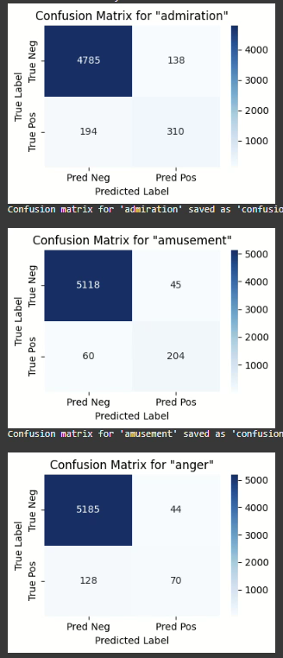
Outcomes/Findings
Confusion Matrices were created for each emotion to measure precision, recall and F1 score for each emotion
Metrics weren't entirely related to the frequency of available data as some classes with low data count also has high F1 score
Metrics weren't entirely related to the sentiment groups of ambiguous as well
We believe metrics may be related to a combination of number of samples and interrater correlation.
We also believe F1-score is not always a sufficient criteria for datasets with low data counts for certain classes (e.g., grief)

Slide 27
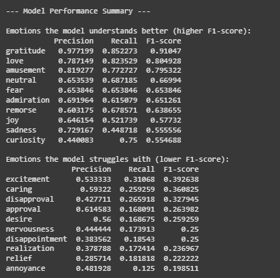
Evaluations – Performance Comparison
Key Findings
Best performance - gratitude, love, and amusement (higher F1-scores).
Poor performance – realization, relief, and annoyance (lower F1-scores).
Low data support possible reason behind lower F1-scores for emotions like nervousness, relief, embarrassment.
Trade-offs observed - "curiosity" has high recall but lower precision, while "approval" has high precision but low recall.
The "neutral" emotion has a moderate F1-score, with decent number of False Negatives suggesting failure to identify neutral instances by model but at the same time we see higher values of False Positives as well showing a certain 'bias' for "neutral" emotion.

Slide 28
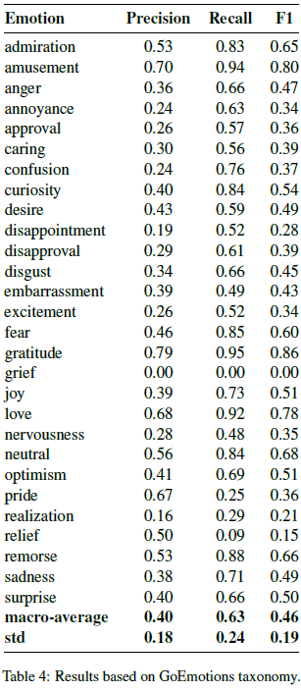
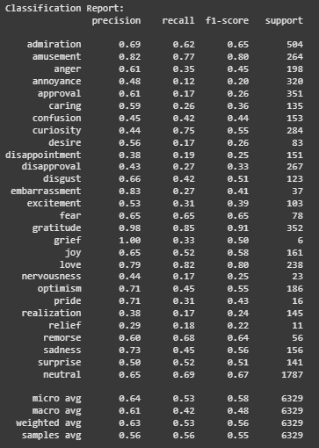
Evaluations – Performance Comparison
Performance observations:
F1 score is the most important metric for imbalanced datasets
Small improvement in F1 score over the original research through the hybrid model
Hybrid model yielded a better precision and poorer recall compared to original model
Sentiment analysis for AI therapy, customer service chatbots prefer precision scores over recall scores
Considering a higher precision and F1 score, we consider our architecture an improvement
Google Research
Our Performance

Slide 29
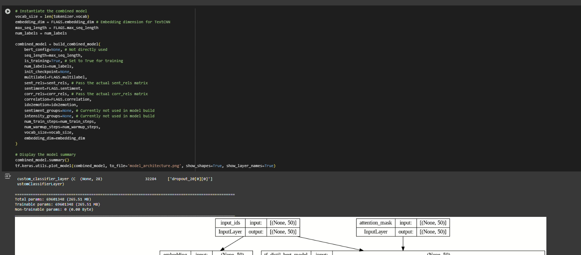
Demo !

Slide 30
Lessons learned and Perspectives
Reusing pre-existing project code is a lot of work, perhaps more than developing new model on existing dataset from scratch
GoEmotions repo has not had meaningful updates for about 4 years
Depended on extremely outdated modules, deprecated and even completely defunct APIs
Had to choose between pinning our code to extremely outdated libraries, losing access to new developments in AI space, or upgrading and refactoring code to supported APIs
Existing code can have incompatibilities in expected ways to run
GoEmotions expected to run from Bash command line, we have Windows
Possible to get working through Windows Subsystem for Linux or Bash emulator
Ultimately migrated to Jupyter Notebook for ease of running and development
Cache all local dependencies, including remote models
HuggingFace updated remote model, broke compatibility with our modules and code and needed upgrades

Slide 31
Lessons learned and Perspectives
Running BERT model is very process-intensive and time-consuming, even more than we expected
Running non-HuggingFace pretrained model on computer without CPU often took 4 hours per run
Multilabel classification on uneven datasets is extremely complicated to solve
Through own trial-and-error and research papers, learned a lot about potential solutions
Downloading model file saves GPU compute costs
For extensive analysis on predicted data, it is better to download the model and run it locally rather than use paid GPU compute
Sentiment analysis needs humongous amounts of labeled data.
For emotions that fared poorly, data augmentation, additional data labeling, oversampling of minority class or undersampling of majority class was necessary.
Investing more time in data preparation and data labelling could possibly yield better results than algorithmic customizations

Slide 32
Bibliographical References
Demszky, Dorottya, Dana Movshovitz-Attias, Jeongwoo Ko, Alan Cowen, Gaurav Nemade, and Sujith Ravi. ‘GoEmotions: A Dataset of Fine-Grained Emotions’, 5 2020. http://arxiv.org/abs/2005.00547.
Sanh, Victor, Lysandre Debut, Julien Chaumond, and Thomas Wolf. ‘DistilBERT, a Distilled Version of BERT: Smaller, Faster, Cheaper and Lighter’, 2019. https://github.com/huggingface/transformers.
Abas, Ahmed R., Ibrahim Elhenawy, Mahinda Zidan, and Mahmoud Othman. ‘Bert-Cnn: A Deep Learning Model for Detecting Emotions from Text’. Computers, Materials and Continua 71 (2022): 2943–61. https://doi.org/10.32604/cmc.2022.021671.
Guo, Yuan, and Hongmei Li. ‘Research on Sentiment Analysis of Online Course Evaluation Based on EN- BERT-CNN’. In Proceedings of the 2024 8th International Conference on Electronic Information Technology and Computer Engineering, 65–68. ACM, 10 2024. https://doi.org/10.1145/3711129.3711142.
Duong, Chi Thang, Remi Lebret, and Karl Abererécole. ‘Multimodal Classification for Analysing Social Media’, 2017.
Tan, Kian Long, Chin Poo Lee, Kalaiarasi Sonai Muthu Anbananthen, and Kian Ming Lim. ‘RoBERTa-LSTM: A Hybrid Model for Sentiment Analysis With Transformer and Recurrent Neural Network’. IEEE Access 10 (2022): 21517–25. https://doi.org/10.1109/ACCESS.2022.3152828.
Kokab, Sayyida Tabinda, Sohail Asghar, and Shehneela Naz. ‘Transformer-Based Deep Learning Models for the Sentiment Analysis of Social Media Data’. Array 14 (7 2022). https://doi.org/10.1016/j.array.2022.100157.
Wang, Shuo, Yuqi Lu, Ruijue Luo, Boxuan Li, Yingjie Zhang, and Liang Xiao. ‘A BERT-Based Sentiment Analysis Model for Depressive Text’. In Proceedings of the 2025 International Conference on Generative Artificial Intelligence and Digital Media, 76–83. ACM, 3 2025. https://doi.org/10.1145/3734921.3734934.
Kim, Yoon. ‘Convolutional Neural Networks for Sentence Classification’, 8 2014. http://arxiv.org/abs/1408.5882.

Slide 33
Bibliographical References
GoEmotions data set: https://www.kaggle.com/datasets/debarshichanda/goemotions Downloaded June 10, 2025
GoEmotions source code: https://github.com/google-research/google-research/tree/master/goemotions Downloaded June 10, 2025
TextCNN: https://github.com/delldu/TextCNN Downloaded July 11, 2025
HuggingFace documentation: https://huggingface.co/docs/transformers/en/model_doc/distilbert
Keras documentation: https://www.tensorflow.org/tutorials/estimator/keras_model_to_estimator https://www.tensorflow.org/guide/migrate/migrating_estimator
F1 Score in Machine Learning. 2025: https://www.futurense.com/Uni-Blog/F1-Score-Machine-Learning.
Classification Metrics Guide: https://www.evidentlyai.com/classification-metrics/accuracy-precision-recall
GoEmotions emotions via emojis: https://neurohive.io/en/datasets/go-emotions-google-ai-dataset-for-sentiment-analysis/#:~:text=31%20October%202021,as%20improve%20customer%20support%20services
Metrics for Sentiment Analysis: https://www.getfocal.co/post/top-7-metrics-to-evaluate-sentiment-analysis-models

Slide 34
Thank You !
AI–570 – Group 12
Manas Ranjan Sahoo
Chelsea Salyards

